Slide 1
15CSE402
Structure and Interpretation of
Computer Programs
Procedures and
Processes they generate

Slide 2
Procedure and Process
Procedure:
Pattern for local evolution of computational process
Process:
Global behaviour of the procedure in the form of shapes

Slide 3
The Factorial Example
n! = n.(n-1).(n-2)...3.2.1
= n.(n-1)!
(or)
= 1.2.3...(n-1).(n-2).n

Slide 4
The Recursive Factorial Procedure
(define (factorial n)
(if (= n 1)
1
(* n (factorial (- n 1)))))

Slide 5
Recursive Process
(factorial 5)
(* 5 (factorial 4))
(* 5 (* 4 (factorial 3)))
(* 5 (* 4 (* 3 (factorial 2))))
(* 5 (* 4 (* 3 (* 2 (factorial 1)))))
(* 5 (* 4 (* 3 (* 2 1))))
(* 5 (* 4 (* 3 2)))
(* 5 (* 4 6))
(* 5 24) 120

Slide 6
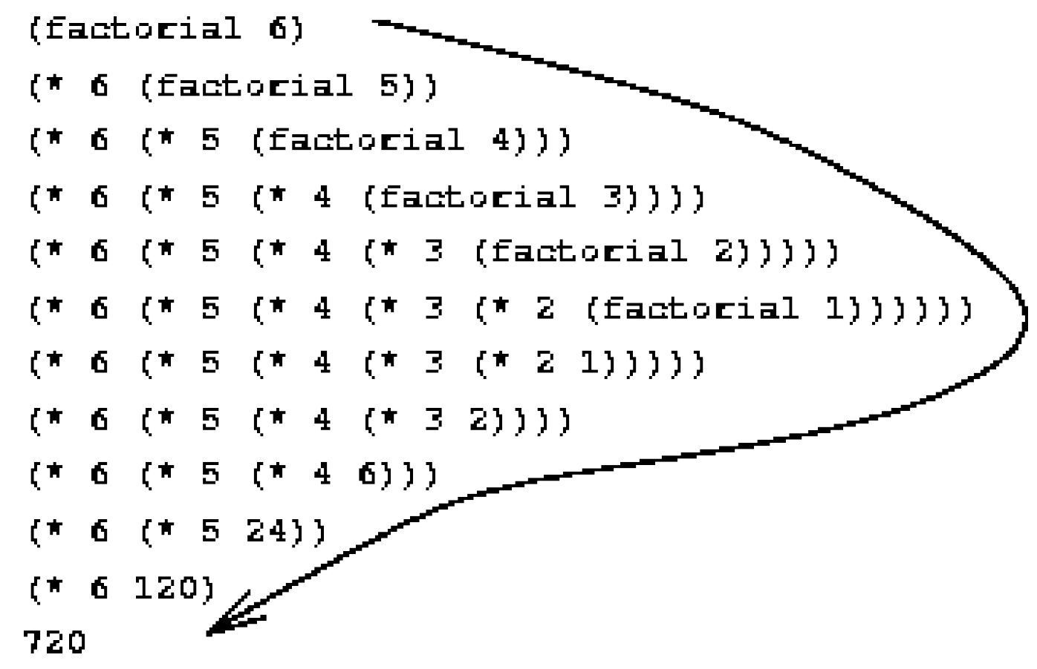
The Linear Recursive Process

Slide 7
Factorial – A Different Perspective
n! = 1.2.3...(n-1).(n-2).n
init counter = 1; product = 1
product ← counter.product
counter ← counter + 1
output product if counter > max-count (= n)

Slide 8
A Tail Recursive Procedure
(define (fact-iter product counter max-count)
(if (> counter max-count)
product
(fact-iter (* counter product)
(+ counter 1)
max-count)
)
)
(define (factorial n)
(fact-iter 1 1 n)

Slide 9
Iterative Process!!
(factorial 5)
(fact-iter 1 1 5)
(fact-iter 1 2 5)
(fact-iter 2 3 5)
(fact-iter 6 4 5)
(fact-iter 24 5 5)
(fact-iter 120 6 5) 120

Slide 10
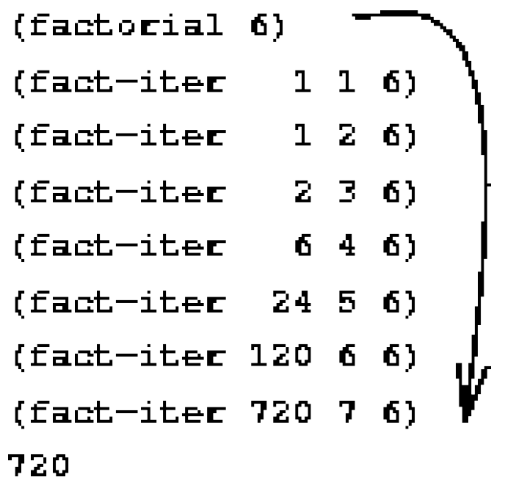
Linear Iterative Process

Slide 11
(define (factorial n)
(if (= n 1)
1
(* n (factorial (- n 1))))
Recursive Procedure 1
(define (fact-iter product counter max-count)
(if (> counter max-count)
product
(fact-iter (* counter product)
(+ counter 1)
max-count)
)
)
(define (factorial n)
(fact-iter 1 1 n)
Recursive Procedure 2

Slide 12
Recursive vs Iterative Processes
(factorial 5)
(* 5 (factorial 4))
(* 5 (* 4 (factorial 3)))
(* 5 (* 4 (* 3 (factorial 2))))
(* 5 (* 4 (* 3 (* 2 (factorial 1)))))
(* 5 (* 4 (* 3 (* 2 1))))
(* 5 (* 4 (* 3 2)))
(* 5 (* 4 6))
(* 5 24)
(factorial 5)
(fact-iter 1 1 5)
(fact-iter 1 2 5)
(fact-iter 2 3 5)
(fact-iter 6 4 5)
(fact-iter 24 5 5)
(fact-iter 120 6 5)

Slide 13
Comparison between the processes
Linear Recursive Process | Linear Iterative Process
Shape - expansion followed by contraction. | The Process does not grow and shrink.
Expansion occurs as the process builds up a chain of deferred operations and contraction occurs as the operations are actually performed. | At each step, all we need to keep track of a set of variables.
The process requires that the interpreter keep track of the operations to be performed later on. | State can be summarized by a fixed number of state variables, together with a fixed rule that describes how the state variables should be updated as the process moves from state to state and an (optional) end test.
Amount of information needed to keep track of deferred multiplications, grows linearly with n (proportional to n) like the number of steps. | The number of steps required grows linearly with n.
There is some additional “hidden” information, maintained by the interpreter. | The program variables provide a complete description of the state of the process at any point.

Slide 14
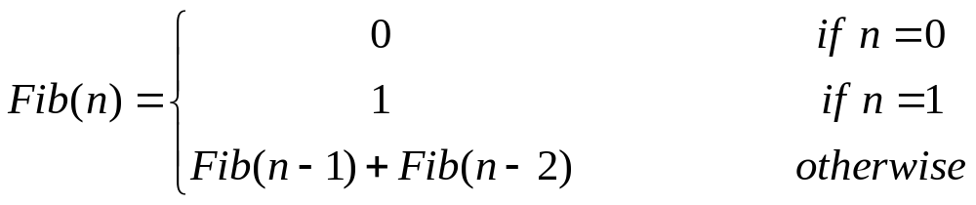
Fibonacci Numbers : Definition
Fib(0) = 0
Fib(1) = 1
Fib(2) = 1
Fib(3) = 2
Fib(4) = 3
Fib(5) = 5
Fib(6) = 8
Fib(7) = 13
Fib(8) = 21
Fib(9) = 34
Fib(10) = 55
Fib(11) = 89
...

Slide 15


Tree Recursion - Fibonacci Numbers
0
1
1
2
3
5
8
13
21
34
55
89
...

Slide 16
Fibonacci Procedure
(define (fib n)
(cond ( (= n 0) 0)
( (= n 1) 1)
(else ( + (fib (- n 1))
(fib (- n 2))
)
)
)
)

Slide 17
The Process Generated by Fibonacci Procedure
(fib 4)
(fib 3)
(fib 2)
(fib 2)
(fib 1)
(fib 1)
(fib 0)
(fib 0)
1
0
(fib 1)
1
1
No. of nodes = 9
No. of steps= 9
0

Slide 18
The Process Generated by Fibonacci Procedure
(fib 5)
(fib 4)
(fib 3)
(fib 3)
(fib 2)
Replicate
(fib 2)
(fib 1)
(fib 1)
(fib 0)
(fib 1)
(fib 0)
1
0
1
1
0
No. of nodes = 15
No. of steps= 15

Slide 19
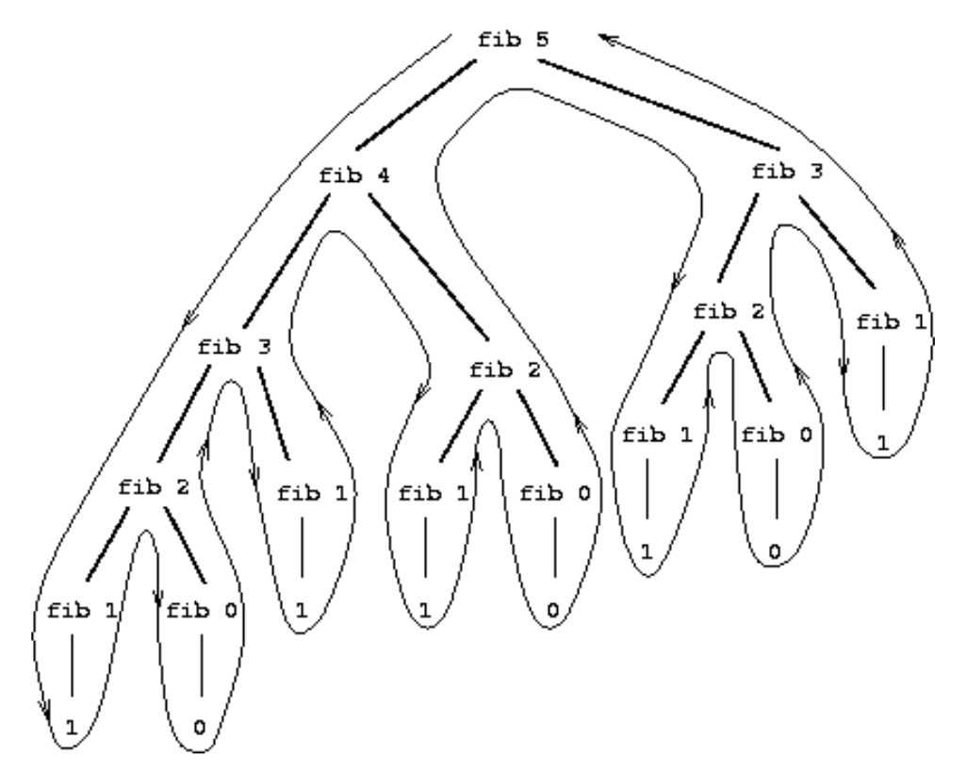
Exponential Tree Recursive Process

Slide 20
Observations
Fib (4)
        No.of nodes = 9
        No. Of steps / functions calls = 9
        Max. Depth = 4
Fib (5)
        No.of nodes = 15
        No. Of steps / functions calls = 15
        Max. Depth = 5
Fib (6)
        No.of nodes = 25
        No. Of steps / functions calls = 25
        Max. Depth= 6
Fib (7)
        No.of nodes = 41
        No. Of steps / functions calls = 41 #Try calculating yourself.
        Max. Depthh = 7

Slide 21
Observations
The entire computation of (fib 3) - almost half the work is duplicated.
The number of times the procedure will compute (fib 1) or (fib 0) (the number of leaves in the tree) is precisely Fib(n + 1).
Steps grow exponentially and space grows linearly with input (because we need keep track only of which nodes are above us in the tree at any point in the computation.)
Number of steps required by a tree recursive process will be proportional to the number of nodes in the tree
Space required will be proportional to the maximum depth of the tree.

Slide 22
Fibonacci Numbers
a : Fib(1) = 1
b : Fib(0) = 0
a ← a + b (≡ Fib(n+1))
b ← a (≡ Fib(n))

Slide 23
Iterative Procedure for Fibonacci
(define (fib-iter a b count)
(if (= count 0)
b
(fib-iter (+ a b) a (- count 1))))
Steps – Linear in n
(define (fib n)
(fib-iter 1 0 n))

Slide 24
Process Generated
(fib 4)
(fib-iter 1 0 4)
(fib-iter 1 1 3)
(fib-iter 2 1 2)
(fib-iter 3 2 1)
(fib-iter 5 3 0)
3

Slide 25
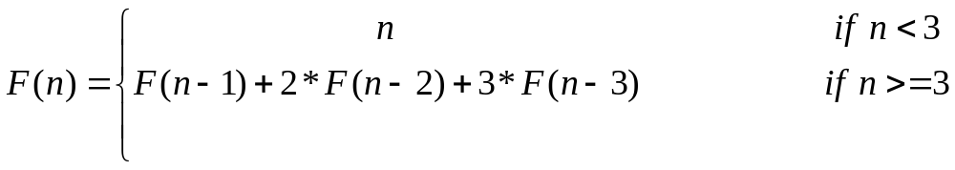
Example : Definition
F(0) = 0
F(1) = 1
F(2) = 2
F(3) = 4
F(4) = 11
F(5) = 25
F(6) = 59

Slide 26
Example : Recursive Code
(define (f n)
(if (< n 3)
n
(+ (f (- n 1)) (* 2 (f (- n 2))) (* 3 (f (- n 3))))
)
)
(f 6)

Slide 27
Example : Iterative / Tail-recursive Code
(define (f-iter a b c n)
(if (= n 0)
c
(f-iter (+ a (* 2 b) (* 3 c)) a b (- n 1))))
(define (f n)
(f-iter 2 1 0 n))
(f 6)

Slide 28
Orders of Growth
Processes can differ considerably in the rates at which they consume computational resources.
The notion of order of growth is used to obtain a gross measure of the resources required by a process as the inputs become larger.

Slide 29

An Expression for Order of Growth

Slide 30
Orders of Growth in time and space for some Common Processes
S.No | Process | No of Steps | Space | Remarks | Example
1. | Linear Recursive | Θ(n) | Θ(n) | No of steps grows proportionally to the input n | Linear Recursive Factorial
2. | Linear Iterative | Θ(n) | Θ(1) | Space is Constant | Linear Iterative Factorial
3. | Tree Recursive | Θ(Φ^{n}) | Θ(n) | Φ – Golden Ratio | Fibonacci

Slide 31
Orders of Growth and process behaviour with change in problem size
Order of Growth | Process Behaviour as problem size is changed
Θ(n²) | Processes requiring n² , 1000n² and 3n² + 10n + 17 all have the same order of growth
Θ(n) | Doubling the size roughly doubles the amount of resources used
Exponential Process | Each increment in problem size multiplies the resource utilization by a constant factor.
Note: Order of growth provides only a crude description of the behaviour of a process.

Slide 32
Exponentiation
Procedure for computing the exponential of a given number.
Arguments: base b and a positive integer exponent n and computes b^{n}.

Slide 33
Approach 1: Recursive definition
(define (expt b n)
(if (= n 0)
1
(* b (expt b (- n 1)))))
b^{n} = b.b^{n-1}
b⁰ = 1

Slide 34
Approach 1: Recursive definition
(expt 2 8)
(* 2 (expt 2 7))
(* 2 (* 2 (expt 2 6 )))
(* 2 (* 2 (* 2 (expt 2 5 ))))
(* 2 (* 2 (* 2 (*2 (expt 2 4 )))))
(* 2 (* 2 (* 2 (* 2 (* 2 (expt 2 3 ))))))
(* 2 (* 2 (* 2 (* 2 (* 2 (* 2 (expt 2 2 )))))))
(* 2 (* 2 (* 2 (* 2 (* 2 (* 2 (* 2 (expt 2 1 ))))))))
(2 * (* 2 (* 2 (* 2 (* 2 (* 2 (* 2 (* 2 (expt 2 0 )))))))))
(2 * (* 2 (* 2 (* 2 (* 2 (* 2 (* 2 (* 2 1))))))))
(2 * (* 2 (* 2 (* 2 (* 2 (* 2 (* 2 2)))))))
(2 * (* 2 (* 2 (* 2 (* 2 (* 2 4))))))
(2 * (* 2 (* 2 (* 2 (* 2 8)))))
(2 * (* 2 (* 2 (* 2 16))))
(2 * (* 2 (* 2 32)))
(2 * (* 2 64))
(2 * 128)
256
Requires:
O(n) Expansion steps / recursive calls
O(n) Reduction steps
O(n) space.

Slide 35
Approach 2: Linear Iteration
(define (expt-iter b counter product)
(if (= counter 0)
product
(expt-iter b
(- counter 1)
(* b product))))
(define (expt b n)
(expt-iter b n 1))

Slide 36
Approach 2: Linear Iteration
(expt 2 8)
(expt-iter 2 8 1)
(expt-iter 2 7 2)
(expt-iter 2 6 4)
(expt-iter 2 5 8)
(expt-iter 2 4 16)
(expt-iter 2 3 32)
(expt-iter 2 2 64)
(expt-iter 2 1 128)
(expt-iter 2 0 256)
256
Requires:
O(n) steps / tail-recursive calls
O(1) space.

Slide 37
Approach 3: Successive Squaring
Example:
b⁸ = b . ( b .( b .( b. ( b .( b. ( b. b ) ) ) ) ) )
  Computing using 3 multiplications:
  b² = b . b
  b⁴ = b² . b²
  b⁸ = b⁴ . b⁴
  Works fine for powers of 2.

Slide 38
Approach 3: Successive Squaring – General Rule
  Rule 1:
  b^{n} = (b^{n/2})² if n is even
  Rule 2:
  b^{n} = b . b^{n-1} if n is odd

Slide 39
Approach 3: Fast Exponentiation
(define (even? n)
(= (remainder n 2) 0)
)
(define (fast-expt b n)
(cond ((= n 0) 1)
((even? n) (square (fast-expt b (/ n 2))))
(else (* b (fast-expt b (- n 1))))))

Slide 40
Approach 3: Fast Exponentiation
(fast-expt 2 8)
(square (fast-expt 2 4))
(square (square (fast-expt 2 2)))
(square (square (square (fast-expt 2 1))))
(square (square (square (* 2 (fast-expt 2 0) ))))
(square (square (square (* 2 1 ))))
(square (square (square 2)))
(square (square 4))
(square 16)
256
Θ(log n) steps / recursive calls
Θ(log n) space

Slide 41
Growth of Fast Exponentiation
b^{2n} using fast-expt requires only one more multiplication than computing b^{n}.
The size of the exponent to compute therefore doubles (approximately) with every new multiplication allowed.
Thus, the number of multiplications required for an exponent of n grows about as fast as the logarithm of n to the base 2.

Slide 42
Growth of Fast Exponentiation
The process has (log n) growth
The difference between (log n) growth and (n) growth becomes striking as n becomes large.
For example, fast-expt for n = 1000 requires only 14 functions calls / multiplications
expt-iter () requires 1000 function calls / multiplications.
Expt() requires 1000 expansions and 1000 reductions.

Slide 43
Greatest Common Divisor
The largest integer that divides both a and b with no remainder
Example: GCD of 206 and 40 is 2.

Slide 44
Euclid’s Algorithm for GCD
GCD(a, b) = GCD (b,r)
Where r is the remainder when a is divided by b
GCD(206, 40) = GCD (40, 6)
= GCD (6, 4)
= GCD (4, 2)
= GCD (2, 0)
= 2

Slide 45
GCD Procedure
(define (gcd a b)
(if (= b 0)
a
(gcd b (remainder a b))))
Generates Iterative Process
Steps: Grows as the logarithm of the numbers involved.

Slide 46
Try it yourself
A function f is defined by the rule that
f(n) = n if n<3 and f(n) = f(n - 1) + 2f(n - 2) + 3f (n -3) if n> 3.
Write a procedure that computes f by means of a recursive process.
Write a procedure that computes f by means of an iterative process.

Slide 47
Testing for Primality
Self-reading

